Slide 1

Investigation of Social Engineering Attacks (Call, Email, SMS) Using Machine Learning
Course: Investigation IT Incident
Instructor: Professor Dr. Abdul Razaque, PhD & Postdoc
Students: Ali Altynbekov, Timur Kamalov
Group: CTC-241M

Slide 2
Problem Background: Social Engineering
Social engineering → manipulation of people to steal data or gain access.
Common channels:
SMS: spam, fake banking or OTP messages.
Email: phishing, credential harvesting, malicious attachments.
Phone calls: voice scams and robocalls pretending to be bank/support.
Manual investigation of large volumes of messages and logs is slow.

Slide 3
Project Goal & Research Questions
Goal: Build ML-based detectors for:
SMS spam vs ham
Phishing vs legitimate emails
Scam vs normal phone calls
Key questions:
Which channel is most “dangerous” (highest share of attacks)?
Which model works better for social engineering detection (LogReg vs Random Forest)?
What typical words and patterns appear in attacks?
Where are the limitations of this approach?

Slide 4
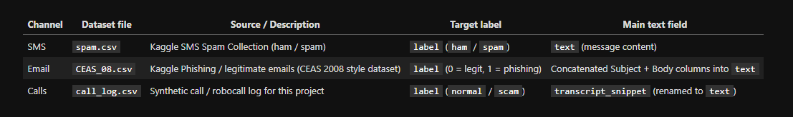
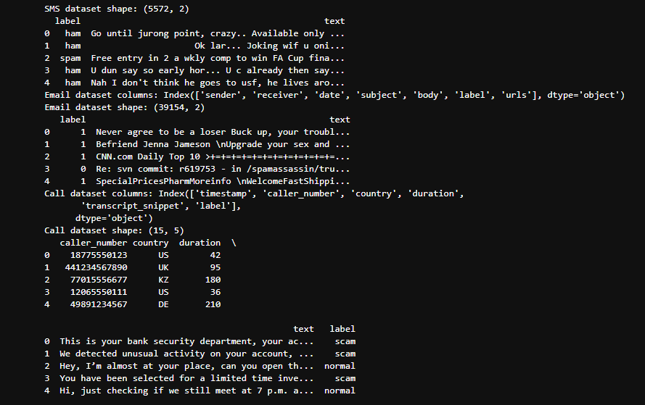
Datasets Overview
SMS (spam.csv) – Kaggle SMS Spam Collection
Thousands of messages labeled as spam / ham.
Fields: label, text.
Email (CEAS_08.csv) – Kaggle phishing email dataset
Labeled phishing / legitimate emails.
Multiple text columns combined into a single text field.
Calls (call_log.csv) – synthetic phone scam dataset
Designed for this project.
Fields: timestamp, caller_number, country, duration, transcript_snippet, label.
Labels unified to a binary target (0 = normal, 1 = malicious).

Slide 5
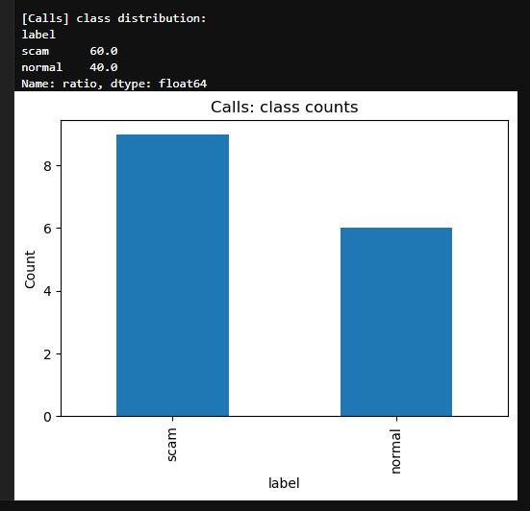
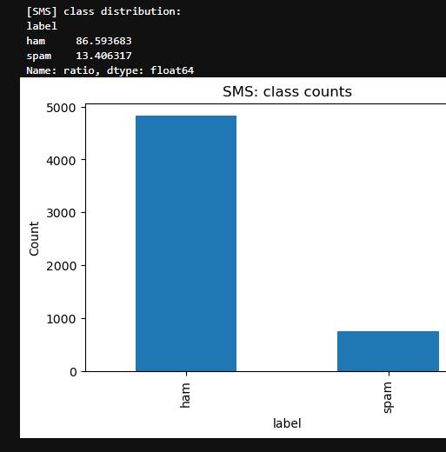
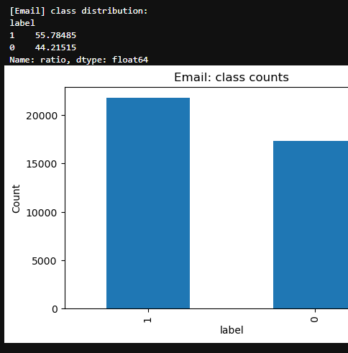
Class Distribution & Message Length
For each dataset:
Class balance (normal vs malicious) is different.
SMS & Email: unbalanced (more normal than malicious).
Calls: small dataset with few samples.
Message length histograms:
Spam / phishing messages often longer and contain more “action words” and URLs.
Normal messages are often shorter and more informal.

Slide 6
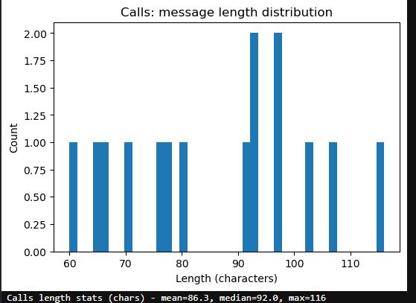
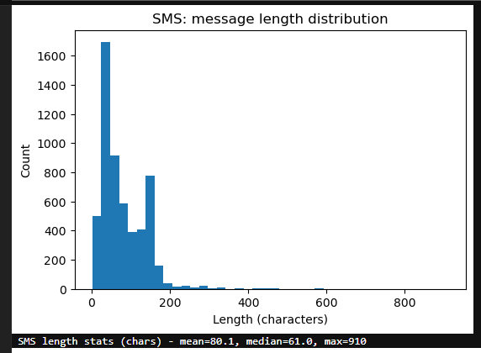
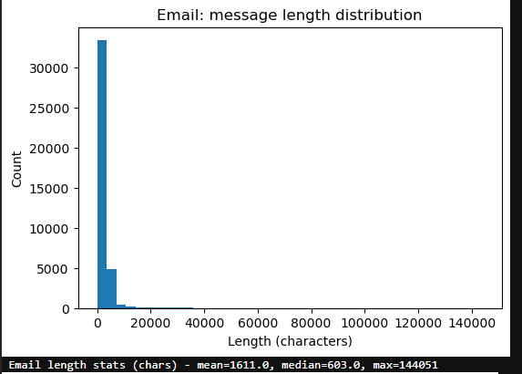

Slide 7
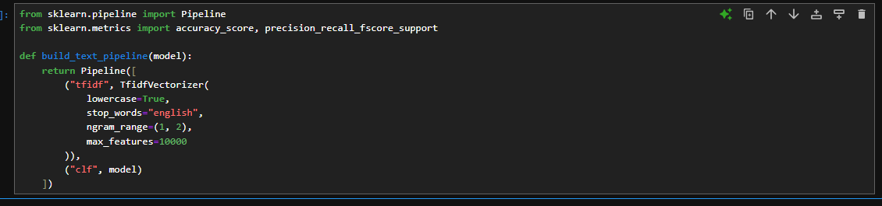
Preprocessing & Feature Extraction
Text preprocessing:
Lowercasing.
Removing English stopwords (handled by TfidfVectorizer).
Using unigrams + bigrams to capture phrases like “verify account”, “urgent action”.
Features:
TF–IDF with up to 10 000 features per channel.
Each channel is modeled separately:
SMS, Email, and Calls have different style and vocabulary.
Separate models let us adapt to each medium.

Slide 8
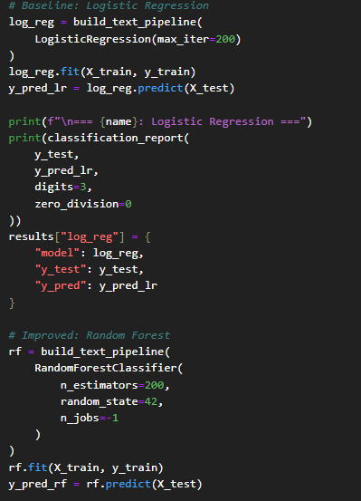
Machine Learning Models
Baseline model: Logistic Regression
Linear model on TF–IDF features.
Works well for text classification and interpretable feature weights.
Improved model: Random Forest
Ensemble of decision trees.
Can capture non-linear patterns and interactions.
Train-test split:
80/20 (or adjusted for small call dataset).
Stratified splits when possible to keep class balance.

Slide 9
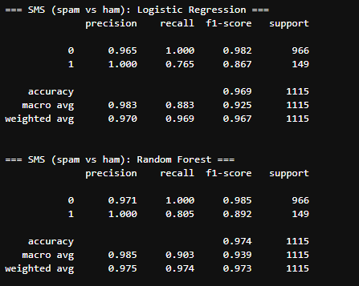
Results: SMS (Spam vs Ham)
Metrics (fill in from channel_model_summary.csv):
Logistic Regression:
  Precision (malicious), Recall (malicious).
Random Forest:
  Precision (malicious), Recall (malicious).
Observations:
SMS spam is relatively easy to detect using TF–IDF.
Typical spam indicators:
  “free”, “win”, “prize”, “call now”, “claim reward”.
Baseline logistic model often already performs very strongly on SMS.

Slide 10
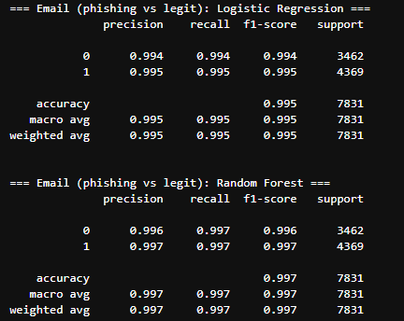
Results: Email (Phishing vs Legitimate)
Metrics (from channel_model_summary.csv):
Logistic Regression: precision/recall for phishing class.
Random Forest: precision/recall for phishing class.
Observations:
Phishing emails mix formal language with urgent tone:
  “verify your account”, “account locked”, “update password”.
Presence of URLs and security / account keywords is important.
Email dataset is more complex than SMS → more overlap between classes.

Slide 11
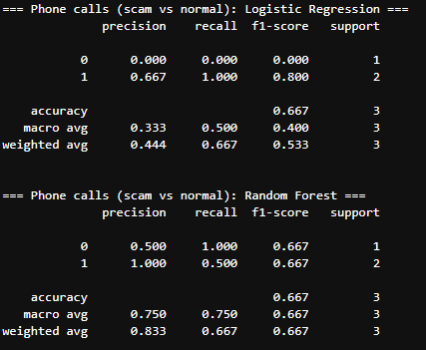
Results: Phone Calls (Scam vs Normal)
Small synthetic dataset from call_log.csv.
Metrics (from channel_model_summary.csv):
Logistic Regression: precision/recall.
Random Forest: precision/recall.
Typical scam call patterns:
“This is your bank… account will be locked… call immediately.”
Threats, urgency, requests for immediate action or payment.
Limitation:
Very few examples → models can overfit and generalize poorly.
Real voice scams would require audio features, not just transcripts.

Slide 12
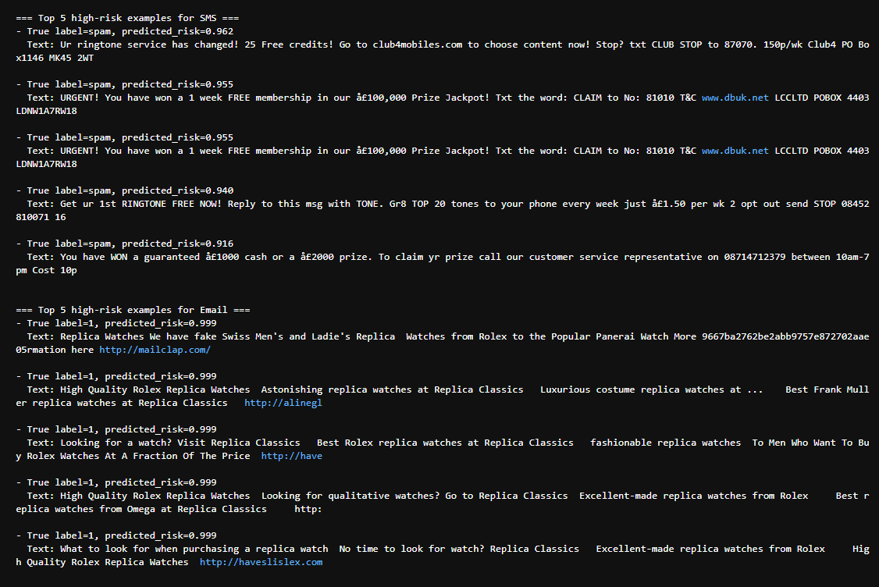
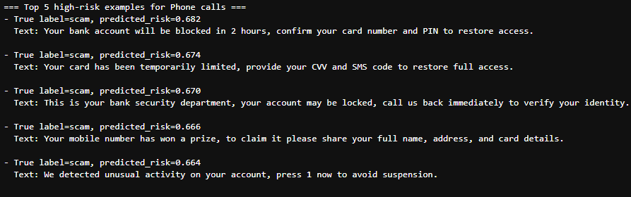
High-Risk Examples & IoCs
For each channel, the model’s highest-risk messages show IoCs:
SMS: lottery, prizes, links to unknown domains.
Email: urgent account verification links, security warnings, login pages.
Calls: threats about “account blocked”, “legal action”, immediate callbacks.
These examples can be used as:
Training material for users.
Patterns to enrich detection rules and SIEM / SOC playbooks.

Slide 13
Discussion: Strengths & Limitations
Strengths:
Unified ML pipeline for SMS, Email, and Calls.
Simple models (LogReg / RF) still reach good precision/recall on text data.
Easy to deploy as part of SOC triage or automated filters.
Limitations:
Imbalanced datasets, especially for certain classes and the call channel.
No deep linguistic or context understanding.
Only text-based transcripts; no audio features, headers, or user behavior context.
Models need regular retraining as attackers change wording.

Slide 14
Conclusion & Future Work
Machine learning can effectively support social engineering detection across multiple channels.
SMS and Email models are more stable because of larger, public datasets.
The phone call channel shows the need for:
Larger, realistic datasets.
Audio-based features (voice, prosody, caller behavior).
Future work:
Use transformer models (e.g., BERT) for better text understanding.
Handle class imbalance (resampling, class weights).
Integrate model outputs into SIEM / SOAR workflows for automated response.

Slide 15
References
Almeida, T. A., Hidalgo, J. M. G., & Yamakami, A. (2011). SMS Spam Collection Data Set. UCI / Kaggle, SMS Spam Collection. https://www.kaggle.com/code/dejavu23/sms-spam-or-ham-beginner/notebook
Naser Abdullah Alam. CEAS 2008 Phishing Email Dataset. Kaggle. https://www.kaggle.com/datasets/naserabdullahalam/phishing-email-dataset/data
call_log.csv created as part of this project.

